Slide 1

Senior Design Project Presentation on REGIONAL LANGUAGE IDENTIFICATION USING MACHINE LEARNING
Presented by:
Ms.Shreya Kumari (2241011259)
Ms. Srijal Rath (2241018088)
Ms. Naina Paikaray(2241016027)
Supervisor:
Prof. Hemant Kumar Palo
Department of Electronics & Communication Engineering
Institute of Technical Education & Research (FET)
Siksha ‘O’ Anusandhan Deemed to be University, Bhubaneswar
May, 2026

Slide 2
Contents
Introduction
Objective
Literature Survey
Design Scheme
Testing, Analysis, And Evaluation
Confusion Matrix
ROC Curve Analysis
Socio-economic Issues Associated With The Project
Engineering Tools And Standards
Conclusion
References

Slide 3
Introduction
Detects Indian regional languages from speech/audio using Machine Learning.
Converts audio into visual features (Mel Spectrograms & Spectrograms) for analysis.
Extracts important speech patterns like frequency, tone, and language features.
Uses ML/DL models for accurate and robust language classification.

Slide 4
Objective
To develop an automated system for identifying Indian regional languages from speech signals.
To extract meaningful audio features using Mel Spectrogram, FFT, and MFCC techniques.
To compare the performance of different Machine Learning and Deep Learning models.
To improve classification accuracy using feature fusion and optimization methods.
To build an efficient and scalable multilingual language recognition system.

Slide 5
Literature Survey
[1]Himanish Shekhar Das and Pinki Roy (2021) used CNN-BiLSTM with Attention on Indian speech datasets and achieved 98.10% accuracy using spectrogram-based deep features.
[2]Zhanyu Ma, Hong Yu, Wei Chen, and Jun Guo (2019) applied LSTM with bottleneck features for short utterance language identification and improved performance on short speech samples.
[3]Ravi Kumar Vuddagiri, Hari Krishna Vydana, and Anil Kumar Vuppala (2019) proposed DNN with Attention using noise-robust acoustic features for better performance under noisy conditions.
[4]Jog, A. H., Jugade, O. A., Kadegaonkar, A. S., and Birajdar, G. K. (2020) used cochleagram-based features with ANN and achieved 95.36% accuracy in language classification.
[5]Farah Adeeba and Sarmad Hussain(2020) combined MFCC, GFCC, spectrogram, and cochleagram features with BiLSTM, showing better accuracy through feature fusion techniques.

Slide 6
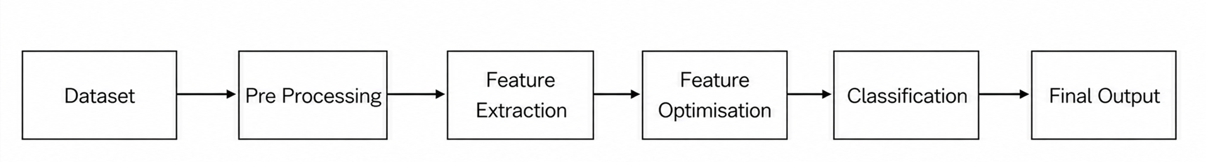
Design Scheme
Fig1.1 System Architecture
Preprocessing | Feature Extraction | Optimization | Classifier
Pre-emphasis Filter | RGB | Adam Optimizer | CNN + Softmax
Normalization | Mel Spectrogram | Adam Optimizer | CNN + Softmax
Framing | Combination Feature | Adam Optimizer | CNN + Softmax
Windowing | — | — | —

Slide 7
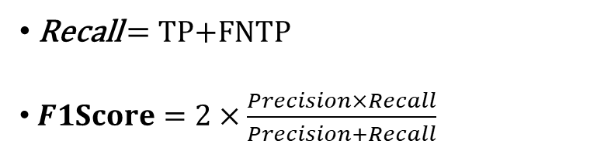
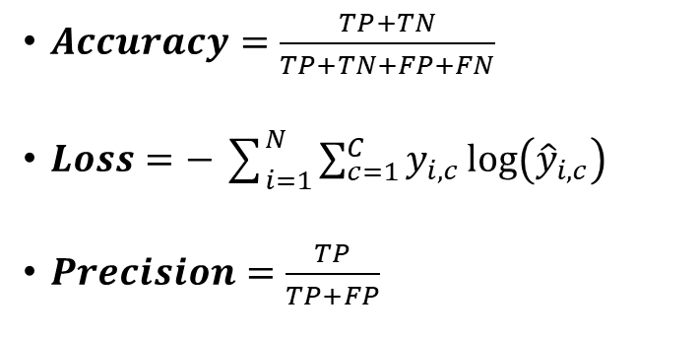
Testing
“The proposed system was tested on IIT Madras speech datasets using multiple ML/DL models.”
Models | Accuracy | Precision | Recall | F1 Score | Loss
NN (CNN) | 99.42% | 99.23% | 99.22% | 99.22% | 0.021
LDA | 99.05% | 99.05% | 99.05% | 99.05% | 0.0753
SVM | 99.35% | 99.36% | 99.35% | 99.35% | --
LR | 99.44% | 99.44% | 99.44% | 99.44% | 0.0203
Random Forest | 90.64% | 90.78% | 90.64% | 90.65% | 0.6325
Evaluation Metrics & Formulae
$Accuracy=\frac{TP+TN}{TP+TN+FP+FN}$
$Loss=−\sum_{i=1}^{N}{\sum_{c=1}^{C}{y_{i,c}}}log⁡\left({\hat{y}}_{i,c}\right)$
$Precision=\frac{TP}{TP+FP}$
Recall = TP+FNTP​
$F1Score=2×\frac{Precision×Recall}{Precision+Recall}$

Slide 8
Results and Analysis
IIT MADRAS DATASET
Model Architecture | Accuracy | Loss | Precision | Recall | F1 Score
RGB+GRAY MODEL | 99.22% | 0.026653 | 0.991667 | 0.992559 | 0.992089
SPECTROGRAM MODEL | 98.85% | 0.039875 | 0.989533 | 0.986193 | 0.987770
PROPOSED DNN FUSION MODEL | 99.60% | 0.014170 | 0.996138 | 0.995648 | 0.995888

Slide 9
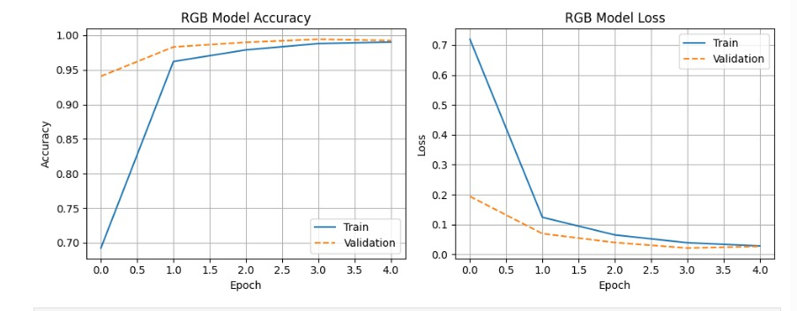
Evaluation
RGB CNN Model Performance Analysis
Fig1. RGB CNN Model Accuracy
Fig2. RGB CNN Model Loss

Slide 10
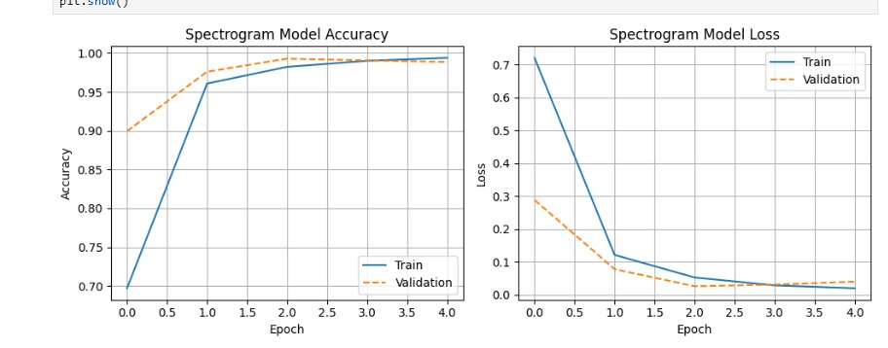
Evaluation(continued)
Spectrogram Model Performance Analysis
Fig3. Spectrogram Model Accuracy
Fig4. Spectrogram Model Loss

Slide 11
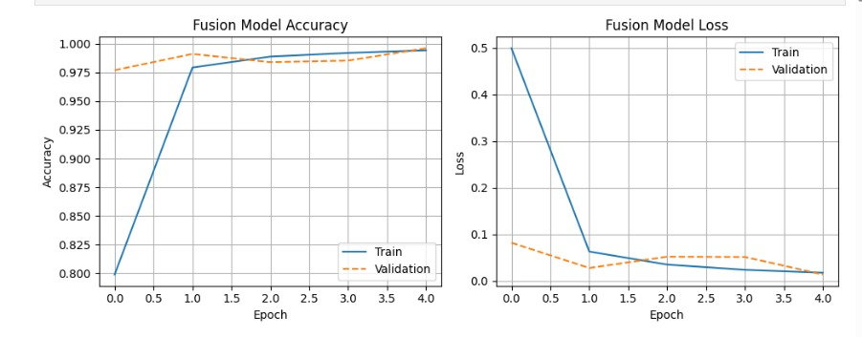
Evaluation(continued)
Fusion Model Performance Analysis
Fig5. Fusion Model Accuracy
Fig6. Fusion Model Loss

Slide 12
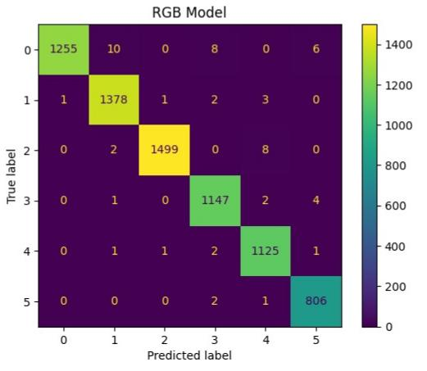
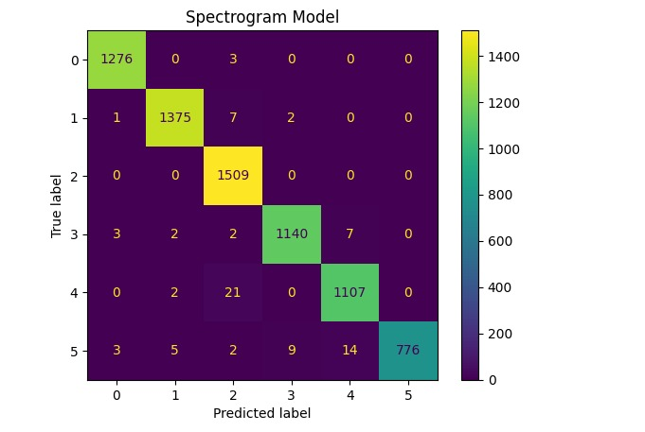
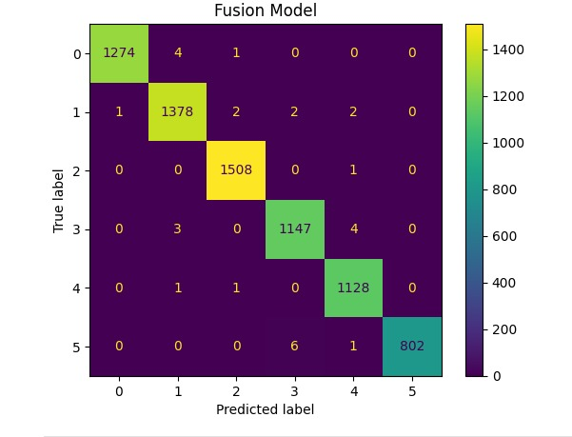
Confusion Matrix Analysis
Fig1 RGB Model
Fig2 Spectrogram
Fig3 Fusion

Slide 13
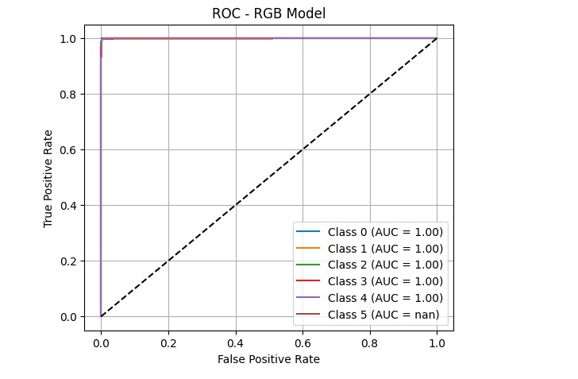
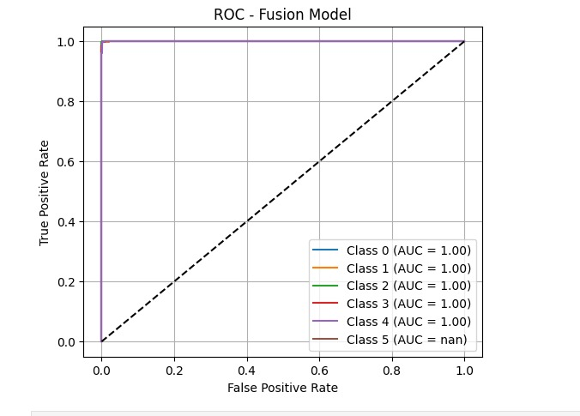
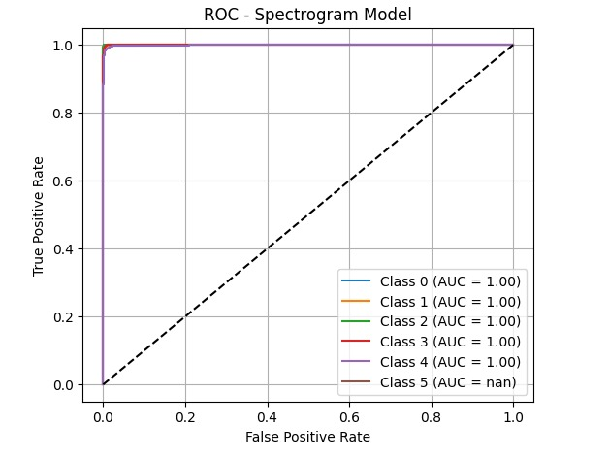
ROC Curve Analysis
Fig1 RGB Model
Fig2 Fusion Model
Fig3 Spectrogram Model

Slide 14
Socio-economic Issues Associated With The Project
Digital Divide:- Rural communities lack tech access for ML language tools.
Language Bias:- Minority languages get less data, lowering model accuracy.
Job Displacement:-Automation threatens human translators and transcriptionists.
Cultural Preservation:- Models may miss dialects, risking linguistic diversity loss.
Privacy Concerns:- Voice data collection raises consent and misuse issues.
Social Inclusion:- Enables native-language access to healthcare, banking and governance.
High Development Cost:- Multi-language ML systems need significant funding and resources.

Slide 15
Engineering Tools And Standards
Engineering Tools:-
Python – Core programming language
TensorFlow & Keras – CNN model development
Scikit‑learn – ML algorithms & evaluation
Librosa – Audio feature extraction
NumPy & Pandas – Data handling & processing
Matplotlib – Performance visualization
Google Colab/Jupyter – Model training environment
Standards:-
Mel Spectrogram & MFCC – Key audio features
16 kHz / 48 kHz – Standardized audio processing
CNN Classification – Deep learning for language ID
Accuracy, Precision, Recall, F1 – Performance evaluation metrics

Slide 16
Conclusion
Proposed Fusion Model achieved the best overall performance on both datasets.
Highest accuracy achieved: 100% with minimum loss on IIT Hyderabad dataset.
Fusion of RGB, Grayscale, and Spectrogram features improved classification accuracy.
CNN models outperformed traditional ML models in language identification.

Slide 17
References
[1] Himanish Shekhar Das, and Pinki Roy. "Impact of Visual Representation of Audio Signals for Indian Language Identification." Advances in Speech and Music Technology: Proceedings of FRSM 2020. Singapore: Springer Singapore, 2021. 395-407. Springer, 2021.
[2] Zhanyu Ma, Hong Yu, Wei Chen, and Jun Guo (2019) "Short utterance based speech language identification in intelligent vehicles with time-scale modifications and deep bottleneck features." IEEE transactions on vehicular technology 68.1 (2018): 121-128.
[3] Vuddagiri, Ravi Kumar, Hari Krishna Vydana and Anil Kumar Vuppala "Multi-head self-attention networks for language identification." 2019 Twelfth international conference on contemporary computing (IC3). IEEE, 2019:(pp. 1-5). IEEE.
[4] Mistry, Yogita D., Gajanan K. Birajdar, and Archana M. Khodke. "Time-frequency visual representation and texture features for audio applications: a comprehensive review, recent trends, and challenges." Multimedia Tools and Applications 82.23 (2023): 36143-36177.
[5] Farah Adeeba, Muhammad Umar and Sarmad Hussain, "Enhancing large vocabulary continuous speech recognition system for urdu-english conversational code-switched speech." 2020 23rd Conference of the Oriental COCOSDA International Committee for the Co-ordination and Standardisation of Speech Databases and Assessment Techniques (O-COCOSDA). IEEE, 2020: (pp. 155-159). I
[6] Venkatesan, Hariraj, T. Varun Venkatasubramanian, and J. Sangeetha. "Automatic language identification using machine learning techniques." 2018 3rd International Conference on Communication and Electronics Systems (ICCES). IEEE, 2018: (pp. 583-588).

Slide 18



